Slide 1

Continuous security for cloud-native applications
Red Hat® Advanced Cluster Security
for Kubernetes, powered by StackRox

Slide 2













OpenShift Platform Plus
Multicluster management
Cluster security
Global registry
Observability | Discovery | Policy | Compliance | Configuration | Workloads
Declarative security | Container vulnerability management | Network segmentation | Threat detection and response
Image management | Security scanning | Geo-replication Mirroring | Image builds
Manage workloads
Build cloud-native apps
Data-driven insights
Developer productivity
Platform services
Application services*
Data services*
Developer services
• Service mesh | Serverless • Builds | CI/CD pipelines
• Log management • Cost management
• Languages and runtimes
• API management
• Integration
• Messaging
• Process automation
• Databases | Cache • Data ingest and prep
• Data analytics | AI/ML • Data management & resilience
• Developer CLI | IDE
• Plugins and extensions • CodeReady workspaces • CodeReady containers
Kubernetes cluster services Install | Over-the-air updates | Networking | Ingress | Storage | Monitoring | Logging | Registry | Authorization | Containers | VMs | Operators | Helm charts
Kubernetes (orchestration)
Linux (container host operating system)
Physical
Virtual
Private cloud
Public cloud
Edge

Slide 3



Security must be continuous and holistic
Control Application Security
Protect the Platform
Detect & Respond to Runtime Threats
DESIGN
ADAPT
DEPLOY
RUN
Dev
Ops
BUILD
PACKAGE
MANAGE
ADAPT

Slide 4

OpenShift delivers continuous security
Control
Protect
Detect & Respond
ACM
Application Lifecycle and Locality
Fleet Management
Fleet Observability & Alerts
Vulnerability analysis
Policy admission controller
Runtime behavioral analysis
ACS
App config analysis
Compliance assessments
Auto-suggest network policies
APIs for CI/CD integrations
Risk profiling
Threat detection / incident response
Trusted content
Kubernetes platform lifecycle
Container isolation
Container registry
Identity and access management
Network isolation
OCP
Build management
Platform data
Application access and data
CI/CD pipeline
Deployment policies
Observability
BUILD
DEPLOY
RUN
DevSecOps

Slide 5



















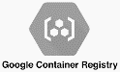




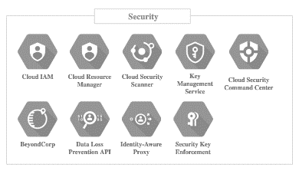



The first Kubernetes-native security platform
Continuous security for cloud-native applications
Red Hat Advanced Cluster Security for Kubernetes
Any Kubernetes distribution
Build
Secure supply chain
Deploy
Secure infrastructure
Run
Secure workloads
Policy engine
API
Image scanning
Registries
CI/CD tools
DevOps notification
SIEM
Run anywhere
Public cloud
Private cloud
Hybrid/Multi-cloud
AWS Security Hub

Slide 6
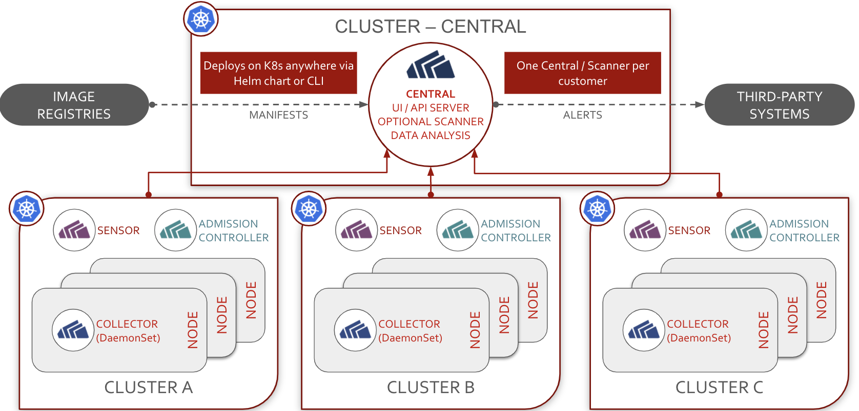
Architecture
Continuous security for cloud-native applications

Slide 7
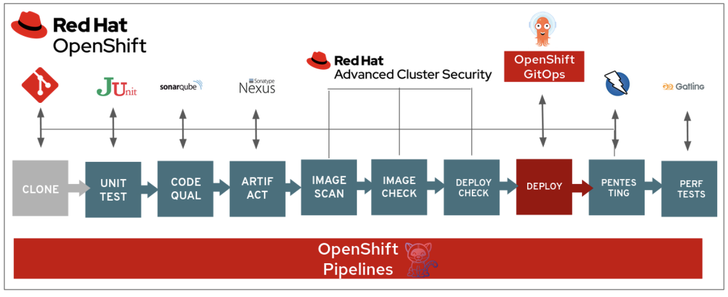
DevSecOps Demo
Vulnerability and configuration management methods included in this demo are the following:
Static application security testing (SAST)
Software composition analysis (SCA)
Interactive application security testing (IAST) and dynamic application security testing (DAST)
Configuration management
Image risk is any risk associated with a container image. This includes vulnerable dependencies, embedded secrets, bad configurations, malware, or images that are not trusted.

Slide 8
DEMO
Notes:
Create Project with nodeselector and tolerations
We will create a physical isolation of pods to run on specific nodes using node-selectors, taints and tolerations.
We will create a dedicated ingress per network zone.
Deploy applications to respective Projects/namespaces and see what happens.
Create network policies
If time: Create a tier 3 app demo using gitops

Slide 9




NetworkPolicy
Deny ALL!!!
SIMPSONS
Marge & Homer
BOUVIER
Selma & Petty
POD
✓
POD
SVC
SVC
POD
✓
POD
✓
POD
POD
SVC
SVC
POD
POD
❌
Notes:
Big thanks to: Robert - https://examples.openshift.pub/networking/network-policy/
Network controls
Everyone can connect to each other, first create Netpol to deny-all
Simpson and Bouvier - default-deny
Simpson and Bouvier allow from openshift-ingress namespaces, because of router
Simpson allow internal communication Homer and Marge
Bouvier allow internal communication Selma and Patty.
Selma and Patty wants to talk with Marge!
Marge wants to talk with Selma and Patty!
Based on labeling or annotations
project / namespaces have labels
Empty label selector match all
Rules for allowing
Ingress -> who can connect to this POD
Egress -> where can this POD connect to
Rules
traffic is allowed unless a Network Policy selecting the POD
traffic is denied if pod is selected in policie but none of them have any rules allowing it
You can only write rules that allow traffic!
Scope: Namespace

